Slide 1



Unlock Real-Time AI-ML
Event Streaming
with Spring and Cloud Native Data Services

Slide 2

introduction
Gregory Green
Principal Solution Architect
VMware By Broadcom

Slide 3
Goal
What is AI/ML?
Agenda
Technologies Spring & Data Services
Cloud Native Architecture
Conclusion

Slide 4
Goal
How can we understand information to make informed decisions quicker?

Slide 5

Information
Letter message content….

Slide 6
Is this information GOOD or BAD?
Is this Real?
Information
Letter message content….
Is this information dangerous?

Slide 7
Artificial
Intelligence
(AI)
Information
Letter message content….

Slide 8
What is Artificial Intelligence (AI)?
AI is technology that emulates human intelligence

Slide 9
What is Machine Learning (ML)?
ML is artificial intelligence using mathematical data algorithms

Slide 10
AI
AI
Is this information GOOD or BAD?
Sentiment Analysis
Is this Real?
Fraud Detection
Information
Letter message content….
Is this information dangerous?
Threat Detection

Slide 11
Main Idea
AI
AI/ML can help humans to understand information to make informed decisions quicker using Models
ML

Slide 12
What is a Model?
Model is a Machine learning trained mathematically algorithm that produces an outcome
Model

Slide 13
AI Models - categories
Classification
Classification is a ML model algorithm to group data by a category
Anomaly
Clustering is ML model algo algorithm to identify deviation for normal trends
Regression
Regression is ML model algorithm predict outputs
Clustering
Clustering is ML model algorithm to group similar points

Slide 14
Sentiment Analysis
Classification
Classification is a ML model algorithm to group data by a category
Fraud Detection
Information
Threat Detection
Letter message content….

Slide 15
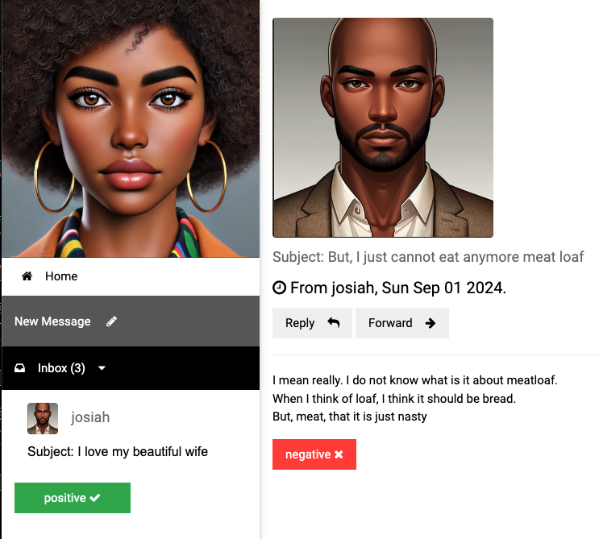
Sentiment Analysis

Slide 16
Getting started with AI/ML
Vector Embedding are a numerical representation of data
App(s)
=>
I love my awesome wife, she is my best friend
[ -0.5539689660072327, -0.04552192986011505, 0.2843276858329773, 0.12018735706806183, -0.4164251685142517, -0.0015744016272947192,
0.8378576636314392, -0.2455213963985443,
0.1919904500246048, 0.3389095067977905, 0.5132707357406616, -0.5949105024337769, -0.05128718167543411, 0.13099819421768188, 0.23817287385463715, 0.16531096398830414, -0.08132422715425491,,… ]

Slide 17
How are vector embeddings generated?
Text Embedding produces vector embedding based on text input
Model
<text-embedding>
App(s)
[ -0.5539689660072327, -0.04552192986011505, 0.2843276858329773, 0.12018735706806183, -0.4164251685142517, -0.0015744016272947192,
0.8378576636314392, -0.2455213963985443,
0.1919904500246048, 0.3389095067977905, 0.5132707357406616, -0.5949105024337769, -0.05128718167543411, 0.13099819421768188, 0.23817287385463715, 0.16531096398830414, -0.08132422715425491,,… ]
=>
I love my awesome wife, she is my best friend

Slide 18
How to perform sentiment analysis?
Model
<text-classification>
Model
<embedding>
App(s)
Text classification determine sentiment such as
VERY_NEGATIVE, NEGATIVE, NEUTRAL, POSITIVE VERY_POSTIVE
Vector embedding
[ -0.5539689660072327, -0.04552192986011505, 0.2843276858329773, 0.12018735706806183, -0.4164251685142517, -0.0015744016272947192,
0.8378576636314392, -0.2455213963985443,
0.1919904500246048, 0.3389095067977905, 0.5132707357406616, -0.5949105024337769, -0.05128718167543411, 0.13099819421768188, 0.23817287385463715, 0.16531096398830414, -0.08132422715425491,,… ]
=>
=>
I love my awesome wife, she is my best friend

Slide 19



How to perform sentiment analysis?
Models
Spring AI
App(s)
Spring AI simplifies the use of ML models such as community libraries like Hugging Face and OpenAI for Java programing applications
I love my wife

Slide 20


How to receive data for sentiment analysis?
Event brokers provides real-time information event streaming
Spring AI
App(s)
Event
Broker

Slide 21


How to store data?
Historical data that is the system of record operational data store
Database

Slide 22

How learn from stored data?
Model
LLM(s)
Vector databases integrate data for Large Language models LLM with similar data as context to provide better outcomes (also known as Retrieval Augmented Generation (RAG).
<Vector>
Database

Slide 23
How learn from stored data?
Model
LLM(s)
<Vector>
Database

Slide 24

How to get results faster?
Provides fast access In-memory
most frequently used data information
Cache

Slide 25


Models
Models
Consumer Sink App
User
App
Event Processor
App
Data Services
Postgres ML
ValKey
RabbitMQ

Slide 26
Cloud Native Platform
Models
Models
Cloud Native platforms such a Kubernetes and Cloud Foundry simplify the deployment of applications and data service and maintain the health and management
Event Processor
App
Consumer Sink App
User
App
Data Services
Postgres ML
RabbitMQ
ValKey

Slide 27
Conclusion
Goal: How can we understand information to make informed decisions quicker?
AI/ML
Help use understand information based mathematically algorithm models
Spring
Simplifies the use of ML models for Java programing applications for inform outcome based decisions
Cloud Data Services
Event streaming brokers like RabbitMQ provides real-time information, Vector databases like Postgres improve model accuracy and caching services like ValKey provide faster data access

Slide 28

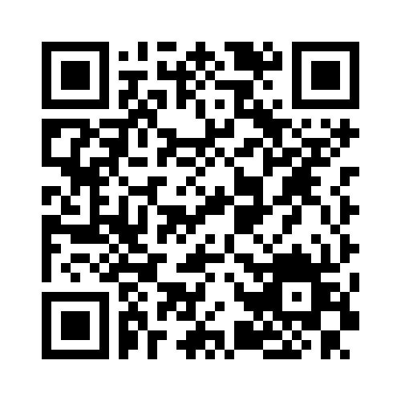
Gregory Green
VMware By Broadcom
Connect with me on
Linked-In
Demo
Source
Code

Slide 29

Cache
Event
Broker
Web App
Database

Slide 30
Why
Understand information better
Making decision fast

Slide 31
Generative
vs
Traditional
AI

Slide 33
VIDEO WILL BE HANDLED BY THE AV TEAMS AND NOT EMBEDDED INTO DECK.
PLEASE SEND DOWNLOAD LINK (NOT ACTUAL VIDEO FILE) TO ATC-TALENT@BLAVITY.COM
VIDEO HERE

Slide 35
Based on this definition, when was the last time you were innovative?

Slide 36
Section Break

Slide 37
Section Break

Slide 38

Add your a question?

Slide 39
Add your a question?

Slide 40
Title of Slide

Slide 41
“Here’s space for a good pull quote to discuss”
First Last, Title

Slide 42
“Here’s space for a good pull quote to discuss”
First Last, Title

Slide 43
Title of Slide
Main Idea One
Data is the first and best way to back-up a solutioning hypothesis and/or prove a hunch in the long run
Main Idea One
Data is the first and best way to back-up a solutioning hypothesis and/or prove a hunch in the long run
Main Idea One
Data is the first and best way to back-up a solutioning hypothesis and/or prove a hunch in the long run
Main Idea One
Data is the first and best way to back-up a solutioning hypothesis and/or prove a hunch in the long run

Slide 44
Title of Slide
Main Idea One
Data is the first and best way to back-up a solutioning hypothesis and/or prove a hunch in the long run
Main Idea One
Data is the first and best way to back-up a solutioning hypothesis and/or prove a hunch in the long run
Main Idea One
Data is the first and best way to back-up a solutioning hypothesis and/or prove a hunch in the long run
Main Idea One
Data is the first and best way to back-up a solutioning hypothesis and/or prove a hunch in the long run

Slide 45
Main Idea One
Main
Idea Goes Here
The state in which every person, regardless of human difference, can access and harness the full power of digital products, without bias, harm or limitation.

Slide 46
Main Idea One
Main
Idea Goes Here
The state in which every person, regardless of human difference, can access and harness the full power of digital products, without bias, harm or limitation.

Slide 47
The state in which every person, regardless of human difference, can access and harness the full power of digital products, without bias, harm or limitation.
Exercise 1

Slide 48
The state in which every person, regardless of human difference, can access and harness the full power of digital products, without bias, harm or limitation.
Exercise 2

Slide 49
Have you asked yourself this question?
This is a block of text that helps add context to the big impactful statement above.

Slide 50
Have you asked yourself this question?
This is a block of text that helps add context to the big impactful statement above.

